Slide 1



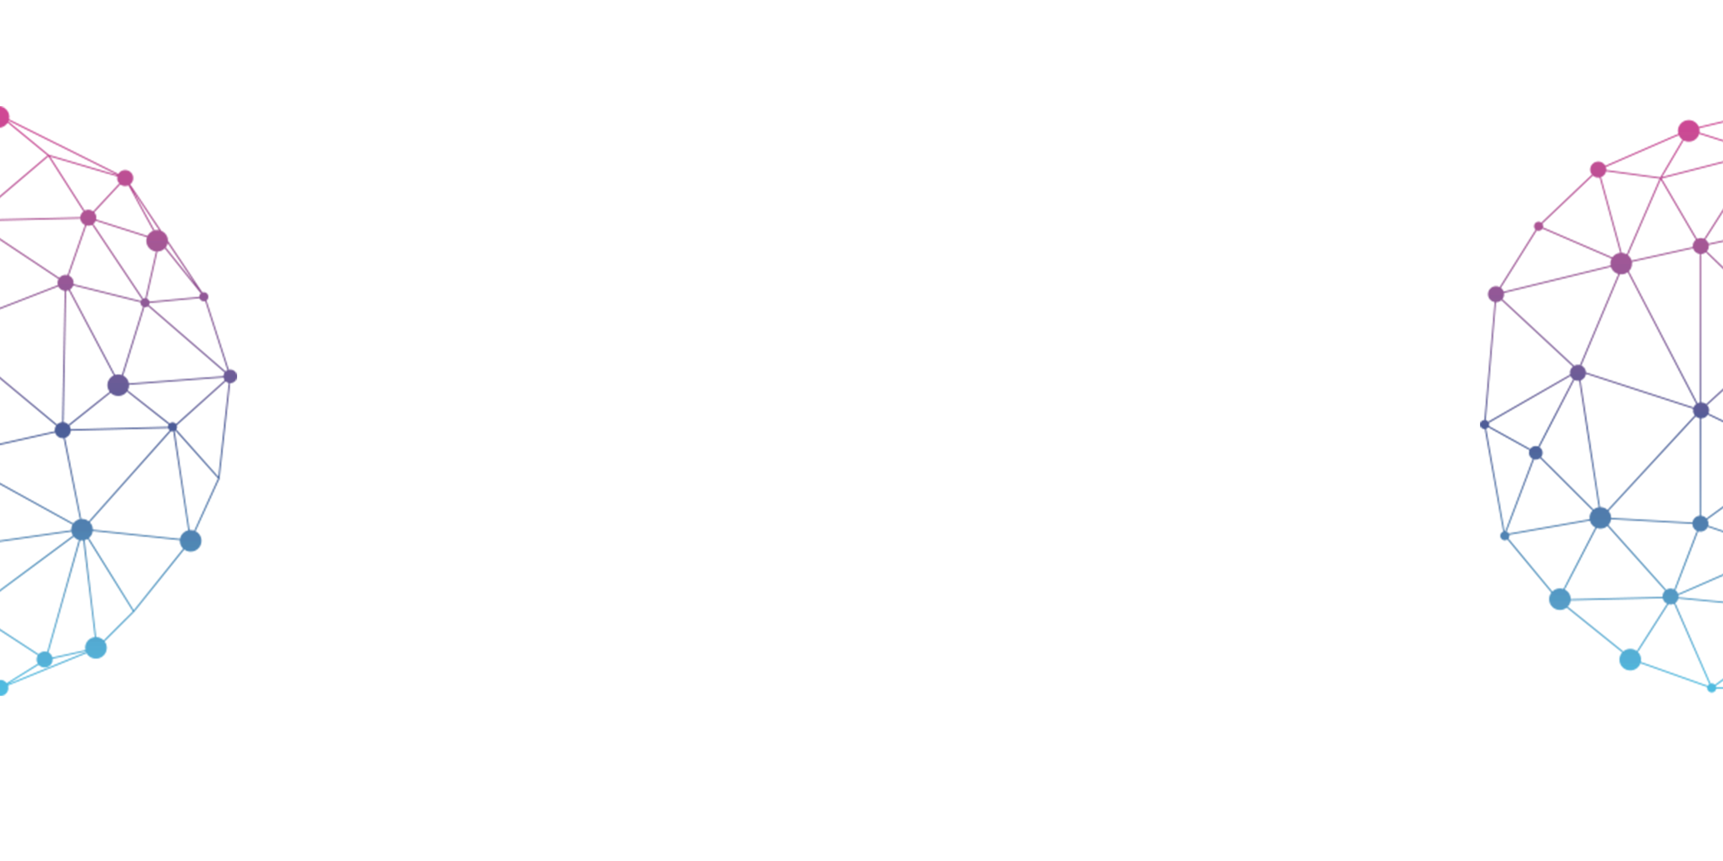

Technical Seminar on
Use of Block Chain for the
Internet of Things
B.Shashidhar
15841A1206
Department of Information Technology

Slide 2

KEY CONTENTS
1
IOT
2
Block Chain
3
Use of B-IOT
4
Applications of B-IOT
5
Conclusion

Slide 3
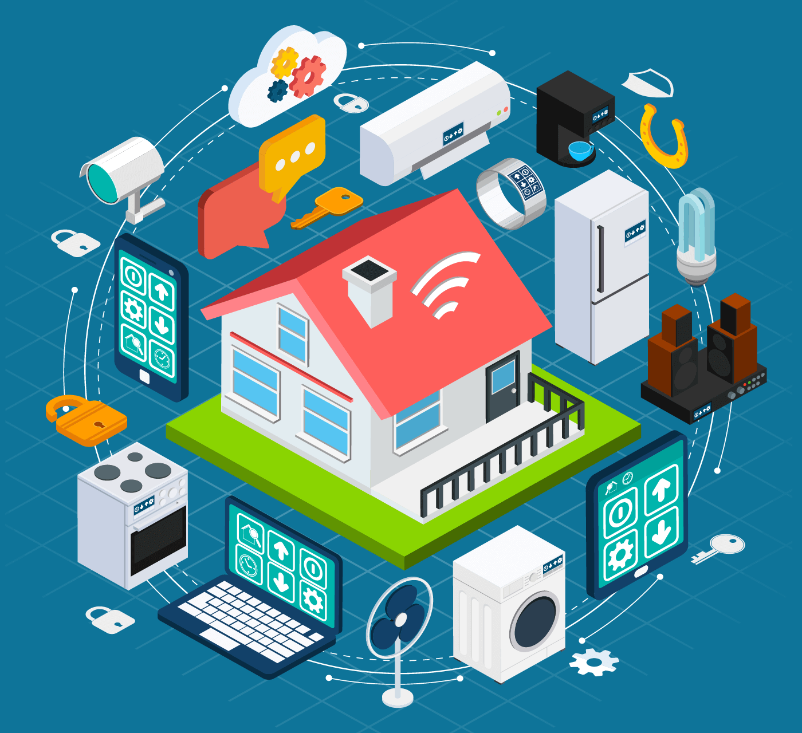
PART- 1
Internet of Things

Slide 4
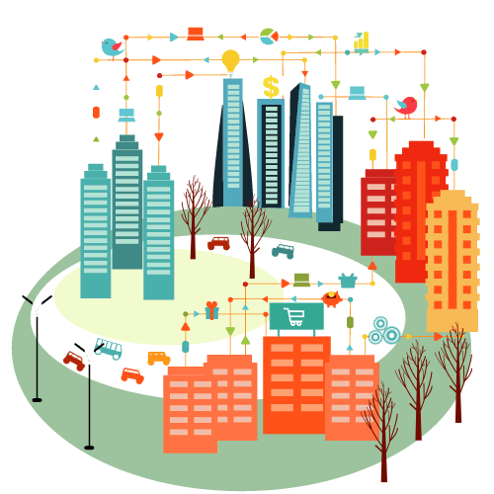
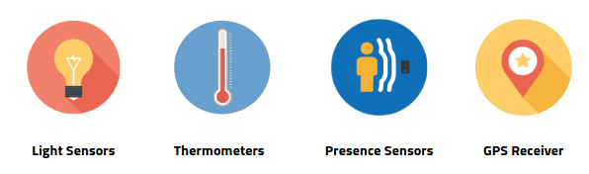
What do you mean by Internet of Things ?
The Internet of things (IoT) is the network of devices such as vehicles, and home appliances that contain electronics, software, sensors, actuators, and connectivity which allows these things to connect, interact and exchange data.

Slide 5
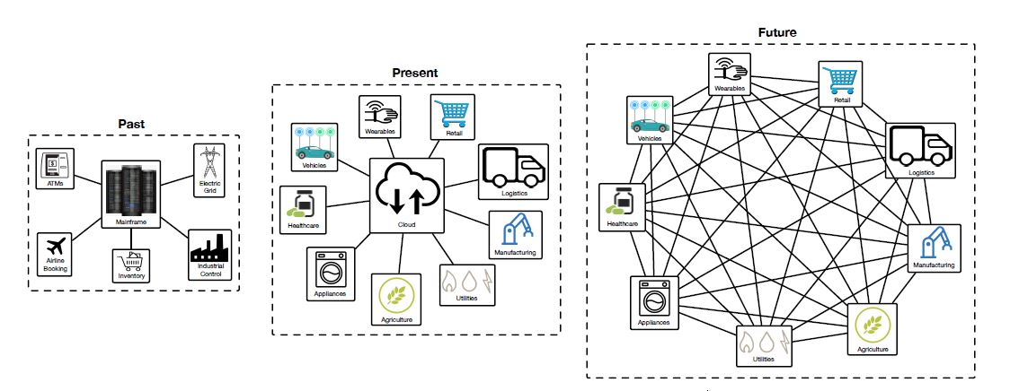
Past, Present, Future IoT Architectures

Slide 6
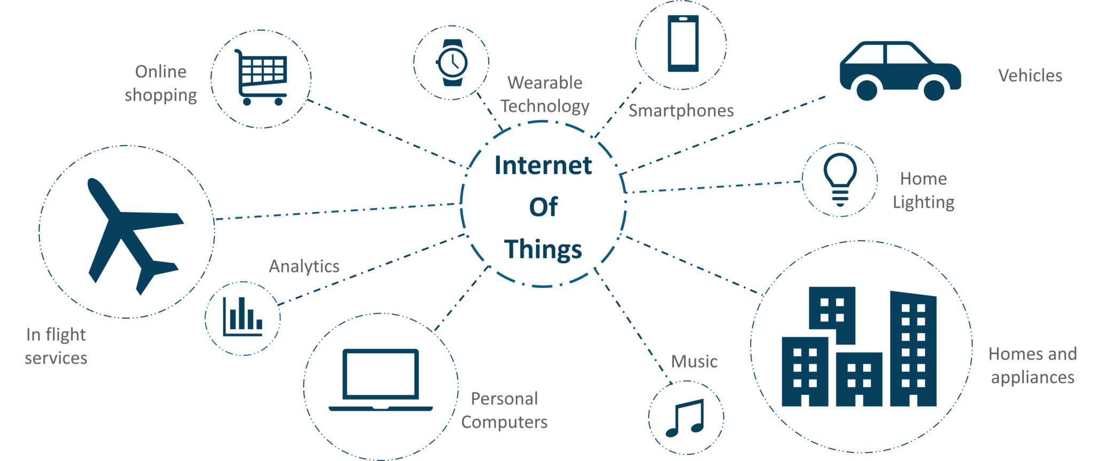
Applications of IoT

Slide 7
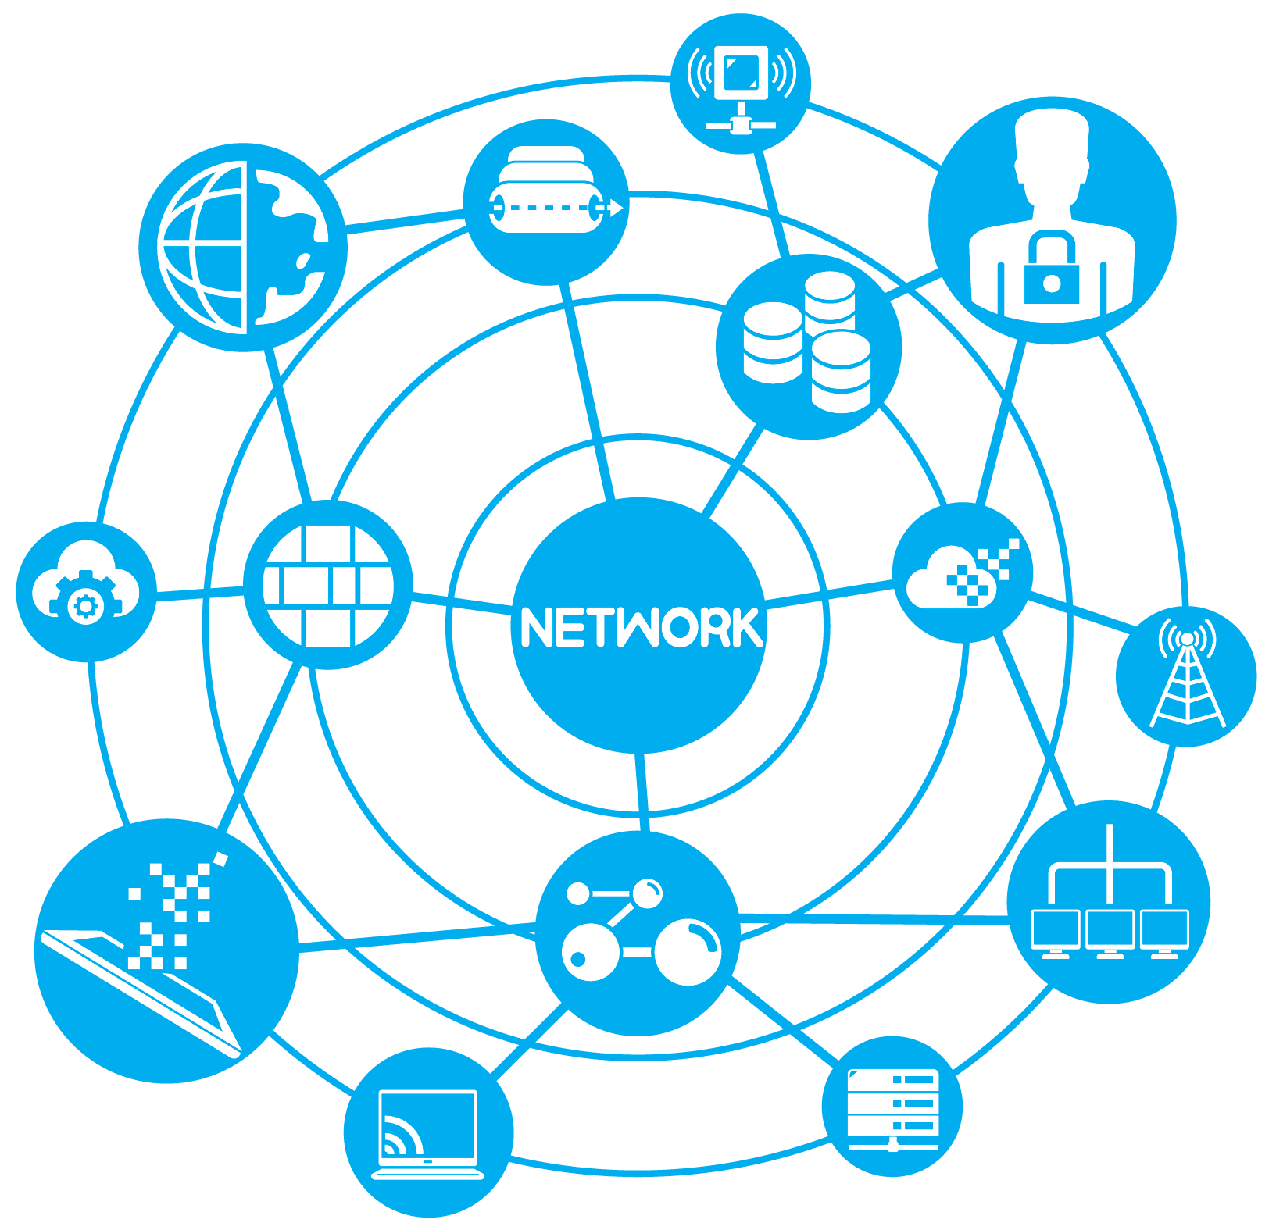
PART-2
Block Chain

Slide 8
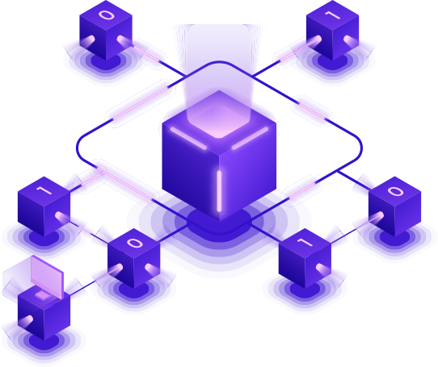
What is Block Chain?
A system in which a record of transactions made in bit coin or another crypto currency are maintained across several computers that are linked in a peer-to-peer network.
Blockchain can be described as a data structure that holds transactional records and while ensuring security, transparency, and decentralization.

Slide 9
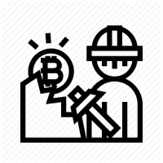



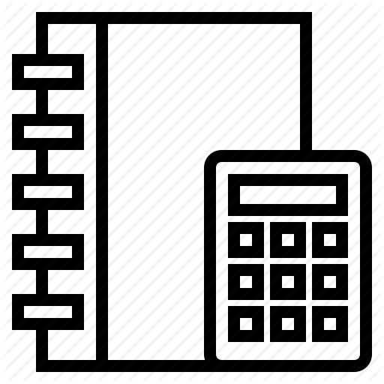
Key Terms of Block Chain Technology
Proof of Work & Proof of Stake
Hash Encryption
Bit coin
Public Distributed Ledger

Slide 10
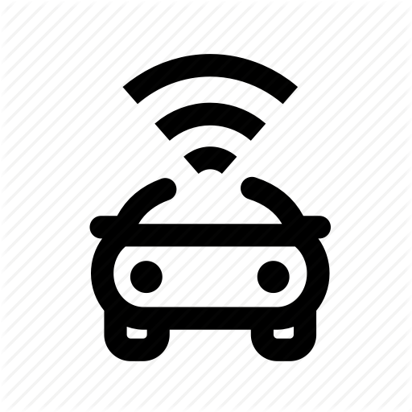



Applications of Blockchain
Automotive
Financial
Voting
Healthcare
Faster, cheaper settlements could save billions of dollars from transaction costs while improving transparency
Using a Blockchain code, constituents could cast votes via smartphones, tablet or computer resulting in immediately verifiable results.
Patient’s Encrypted Health Information could be shared with multiple providers without out the risk of ,privacy breaches
Consumer could use the Blockchain to manage fractional ownership in autonomous cars.

Slide 11
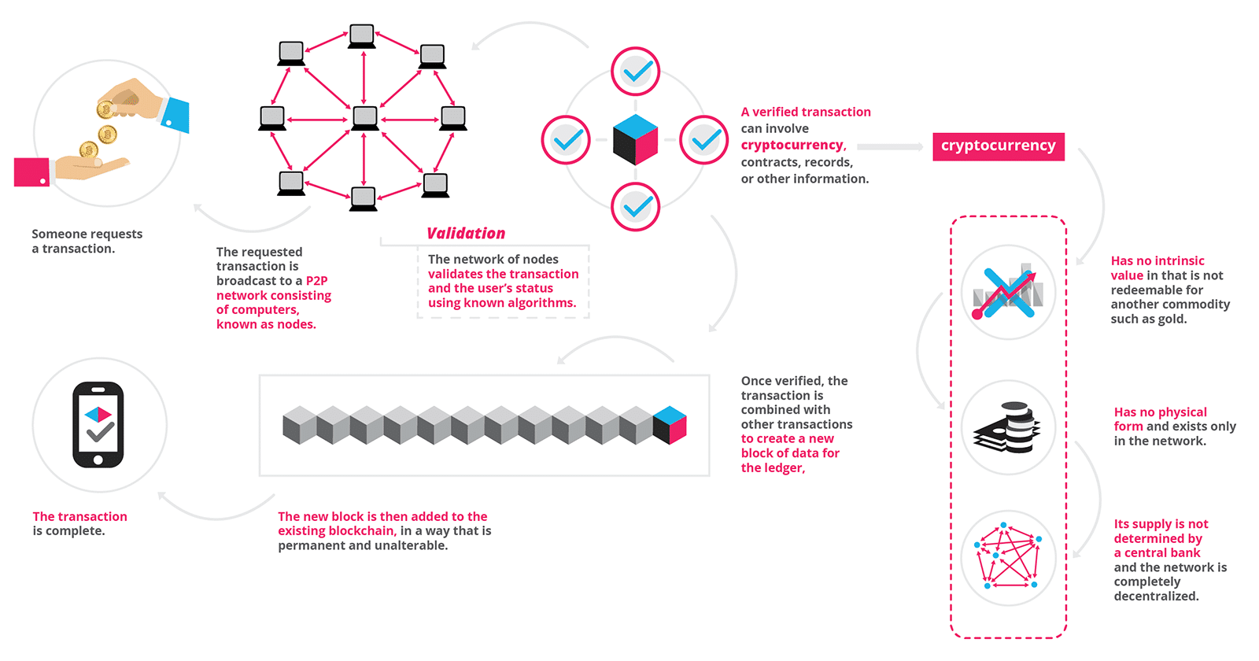

Slide 12
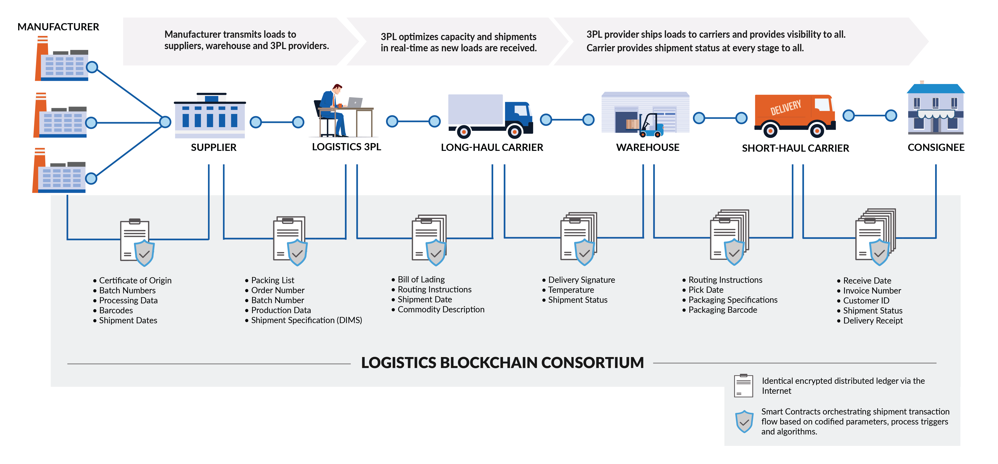

Slide 13
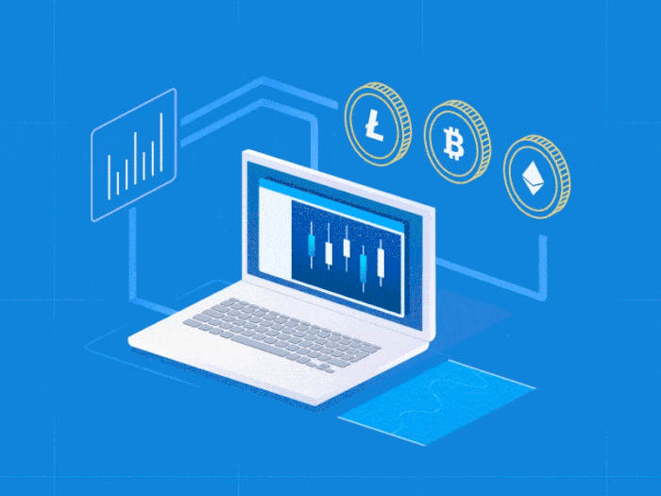
PART - 3
B-IOT

Slide 14

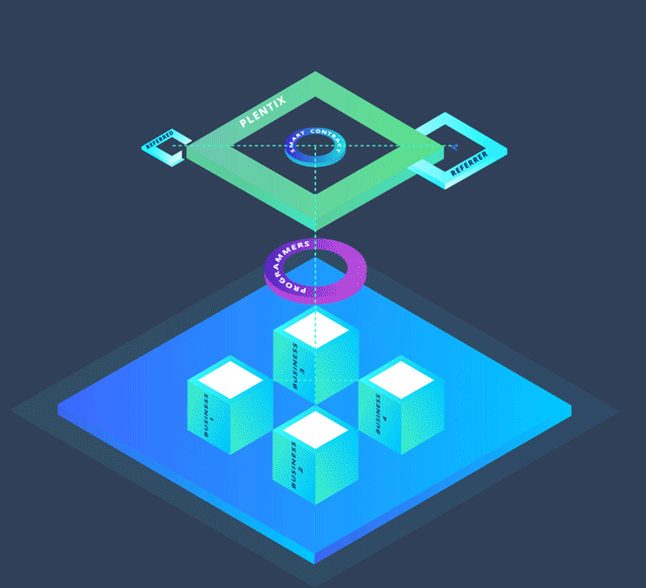
What is B-IOT?
IoT — the interconnection via the Internet of computing devices embedded in everyday objects, enabling them to send and receive data.
Blockchain — an encrypted, distributed computer filing system designed to allow the creation of tamper-proof, real-time records.
B-IOT — it create a verifiable, secure and permanent method of recording data processed by “smart” machines. This network of interconnected devices will be able to interact with their environment and make decisions without any human intervention.

Slide 15
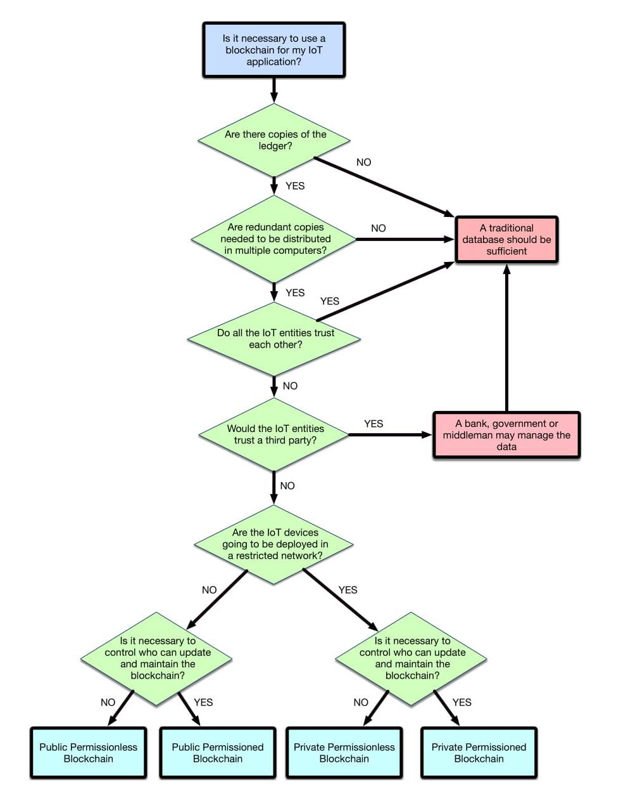
Flow diagram for deciding when to use Blockchain in an IoT application

Slide 16
DESIGN OF AN OPTIMIZED BLOCKCHAIN FOR IOT APPLICATION
ARCHITECTURE
Source/Image-1
CRYPTOGRAPHIC ALGORITHMS
RSA & DHM
CONSENSUS MECHANISMS
Consensus is key for the proper functioning of a Blockchain
MESSAGE TIMESTAMPING
In order to track modifications on the Blockchain
BLOCKCHAIN PROTOCOL STACK
Source/Image-2

Slide 17
Key Benefits of Using Blockchain for IoT
Build Trust between Parties and Devices to Reduce risk of Collusion & Tampering
Reduce Costs by Removing overhead associated with Middleman/Intermediaries
Accelerate Transactions to Reduce settlement time from days to near Instantaneous

Slide 18

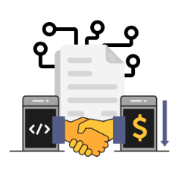

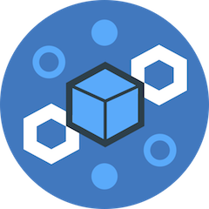

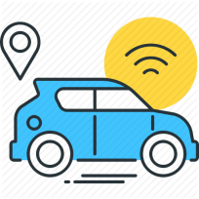
Applications of B-IOT
Retail Industry
Smart Contracts
Public Infrastructure & Smart Cities
Industrial Manufacturing
Connected Vehicle

Slide 19


CHALLENGES FOR B-IOT APPLICATIONS
PRIVACY
ENERGY EFFICIENCY
All the users of a Blockchain are identified by their public key or its hash.
IoT end-nodes usually make use of resource-constrained hardware that is powered by batteries. Therefore, energy efficiency is key to enable a long-lasting node deployment.
SECURITY
THROUGHPUT & LATENCY
Three requirements have to be fulfilled by an information system in order to guarantee its security.
Confidentiality - Integrity - Availability
IoT deployments may require a Blockchain network able to manage large amounts of transactions per time unit.

Slide 20
FURTHER CHALLENGES & RECOMMENDATIONS
Complex Technical Challenges
There are still issues to be addressed regarding the scalability, security, cryptographic development and stability requirements of novel B-IoT applications.
Interoperability & Standardization
Regulatory Aspects
The adoption of B-IoT will require the compromise of all stakeholders in order to achieve full interoperability and integration with legacy
systems.
Besides technological challenges, shaping the regulatory environment is one the biggest issues to unlock the potential value of B-IoT.
4
5
2
1
3
Blockchain Infrastructure
Rapid Field Testing
It will be needed to create a comprehensive trust framework or infrastructure that can fulfill all the requirements for the use of Blockchain in IoT systems.
In the near future, different types of Blockchains for diverse applications will need to be optimized & when users want to combine Blockchain with IoT systems, the first step is to figure out which Blockchain fits their requirements.

Slide 21
CONCLUSIONS
The transition to a data-driven world is being accelerated by the pace of the technological advances of an Internet-enabled global world, the rise of societal challenges, and an increasing competition for scarce resources.
This Presentation examined the state-of-the art of Blockchain technologies and proposed significant scenarios for B-IoT applications in fields like healthcare, logistics, smart cities or energy management.
The aim of this Presentation was to evaluate the practical limitations
and identify areas for further research.
We can conclude that, as in any technological innovation, there is no one-size-fits-all solution for a B-IoT application.

Slide 22
REFERENCES
Science & Technology
IEEE-ACCESS
Research Gate
Google

Slide 23

“Design is not just what it looks like and feels like. Design is how it works.”
–Steve Jobs

